Slide 1


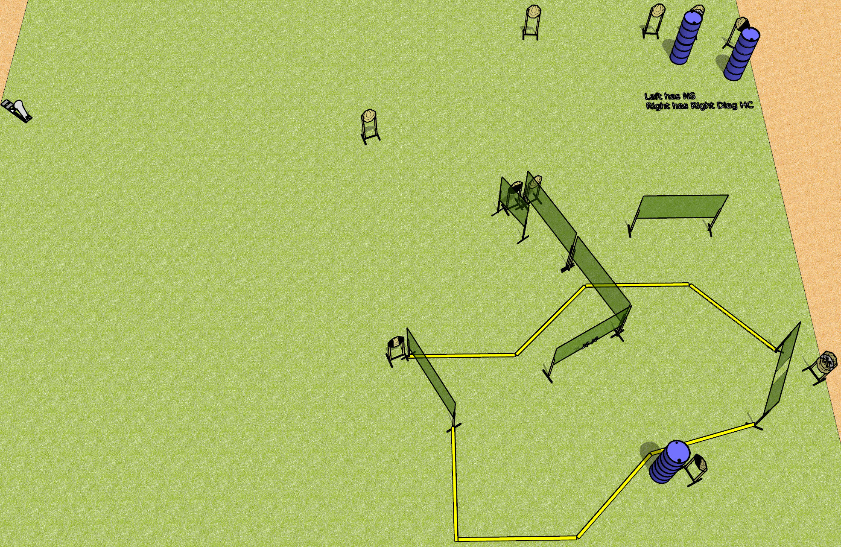
 | Dothan Gun Club – USPSA Match Wall Hacks Course Designer : Drew Coleman
Round Count 23 rounds 11 IPSC 1 colt popper
Equipment List 12 wall feet All 10’ fault lines 1 tux, 1 50%, 1 left and 1 right diag
XX

Slide 2
Wall Hacks
Written Stage Briefing
Wall Hacks is a 23 round, 115 point, Comstock course of fire. There are 11 IPSC targets and 1 colt popper. The best 2 hits on paper will score, and steel must fall to score. The start signal is audible.
Handgun start position is both hands touching marks. Handgun is unloaded and holstered.
PCC start position is muzzle touching either mark, stock on belt. Unloaded carbine is held with both hands.
On start signal, engage targets as they become available from within the shooting area.

